Slide 1
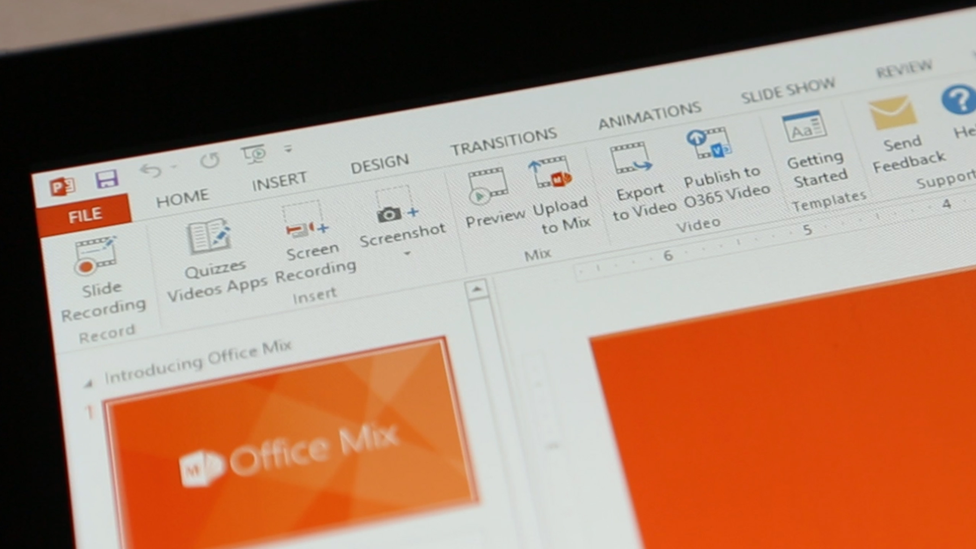

An Introduction
Record, write and draw on your slides. Add quizzes, labs and interactive content.
Upload your lesson to the Microsoft Cloud.
Share a link with your students to watch in any browser
Analytics for every slide and every student. Students see quiz results instantly.
mix.office.com
Notes:
Why don’t you give some superpowers to your PowerPoint lesson ?
Turn your PowerPoint into an interactive online presentation
Works on office 2013 – higher

Slide 2

Benefits
Student
Access the lesson anywhere and anytime
Revise their lesson at their own pace
Receive instant feedback
Teacher
Add quizzes ,polls ,videos ,
interactive elements
Get Instant analytics
Instant results for online quizzes
Flipped classroom environment
Learn More
Notes:
Benefits
In case of student absent – he can easily keep up with the rest of the class because he has access to what was taught that day .
Every student can repeat the lesson as many times as he wants

Slide 3
An Introduction
Get Office Mix
Record Your Mix
Upload & Share

Slide 4
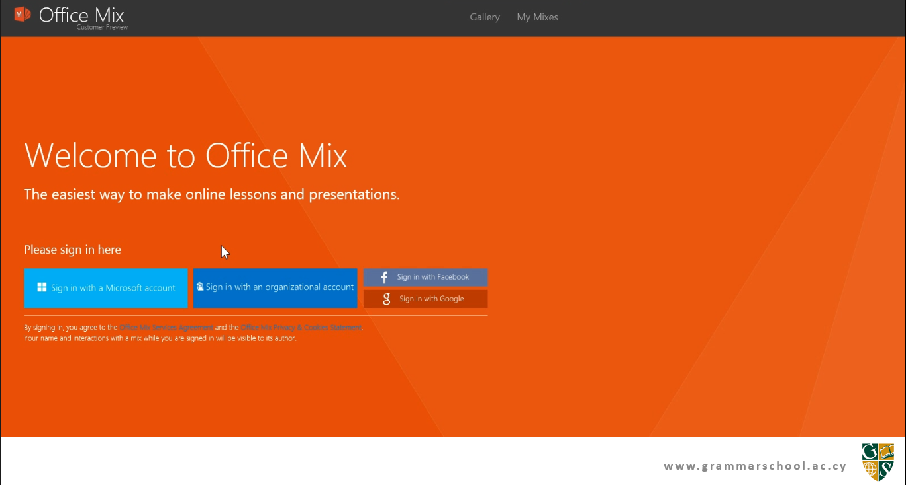
Analytics ‘By Slide’
Get Office Mix
Record Your Mix
Upload & Share

Slide 11
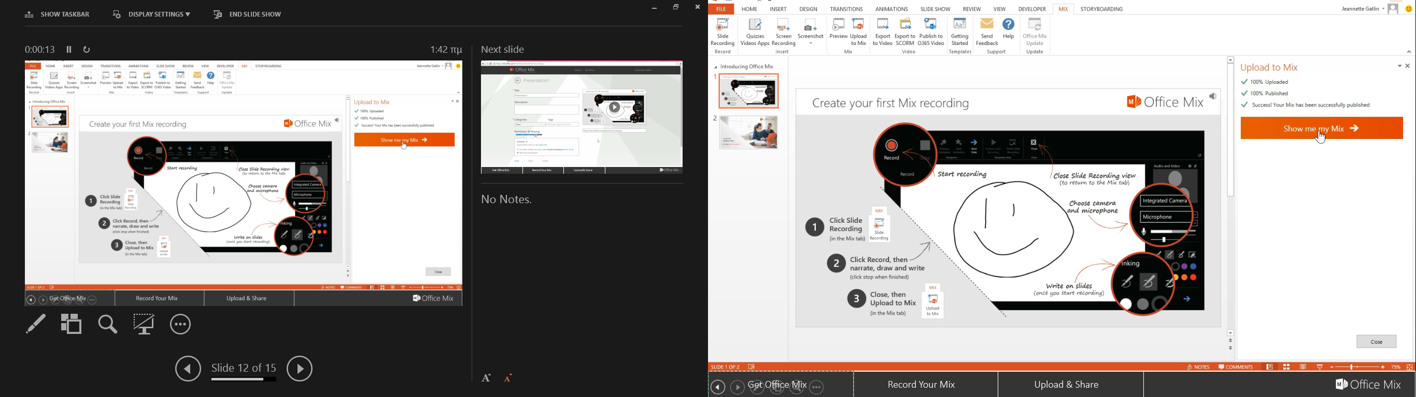

Slide 12
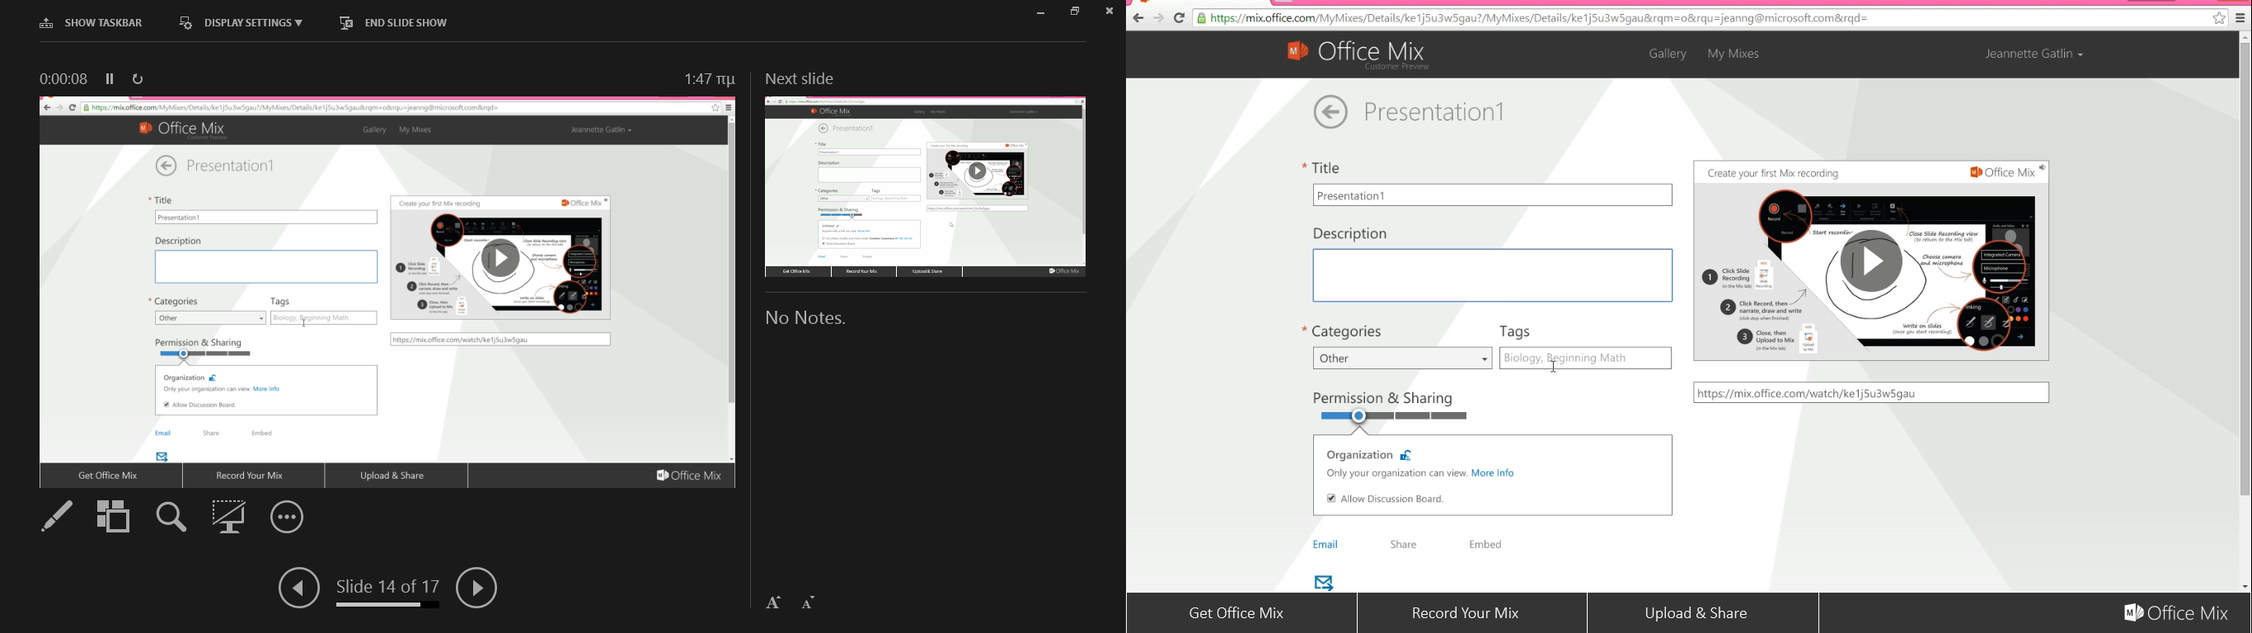
Notes:
Organization , limited, unlisted , public
Tags is always good to use so- easier for users to find
Once you are done hit save

Slide 13
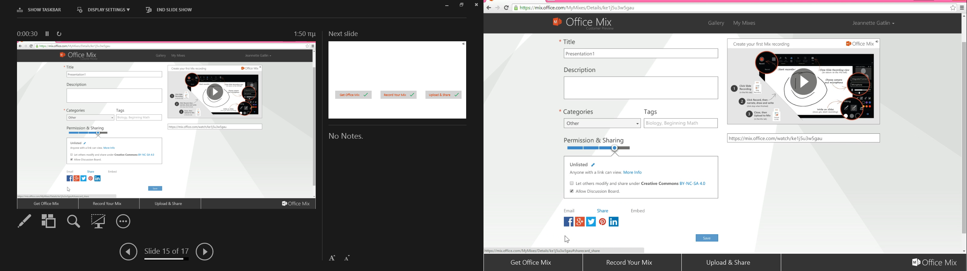
Record Your Mix
Upload & Share
Notes:
Share by url
Share by social media View it anytime at mix.office.com/mymixes
Embed in a web site
Or email it to

Slide 14


mix.office.com
www.grammarschool.ac.cy
Analytics ‘By Slide’
Get Office Mix
Record Your Mix
Upload & Share

