Slide 1
How to Setup a Blog
A STEP BY STEP GUIDE

Slide 2
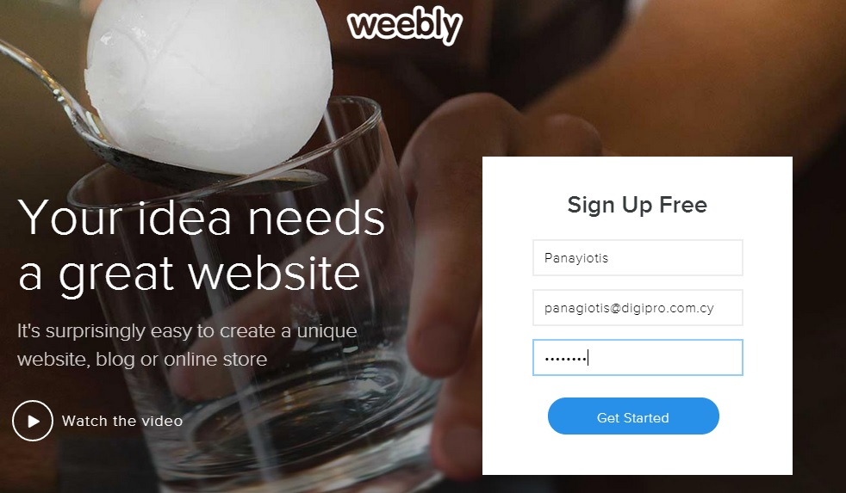
create an account @ weebly.com

Slide 3
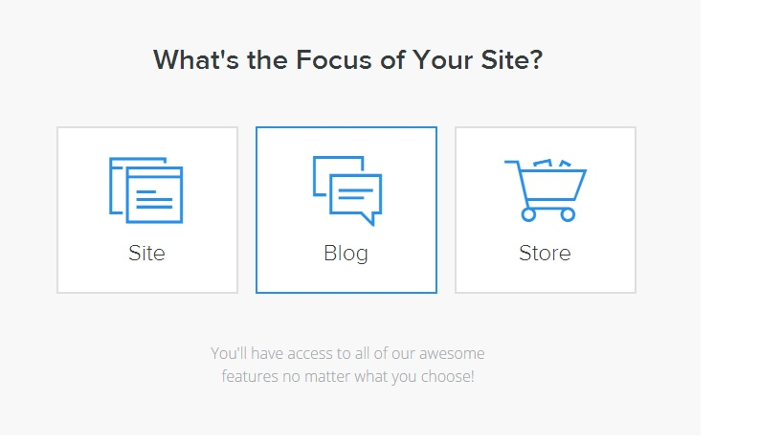
Choose option: blog

Slide 4
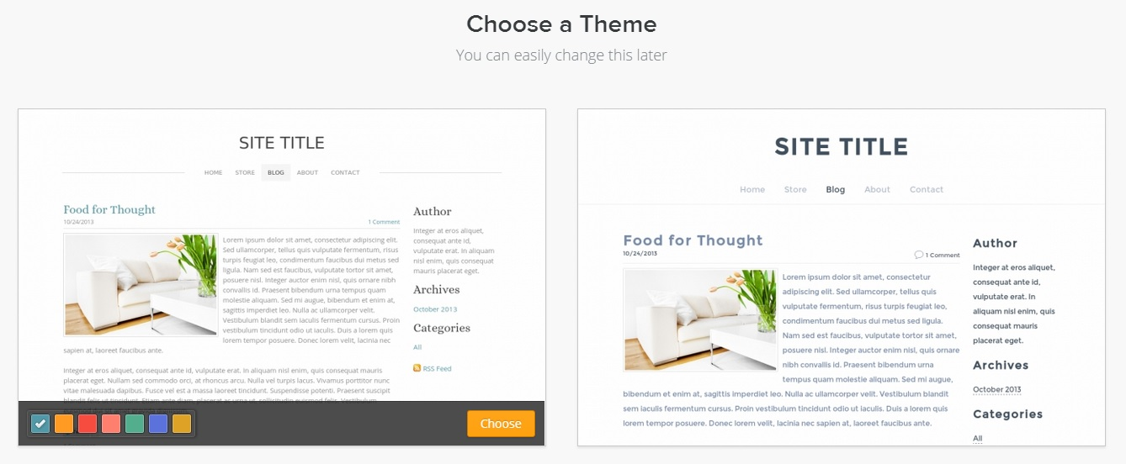
Choose a theme

Slide 5
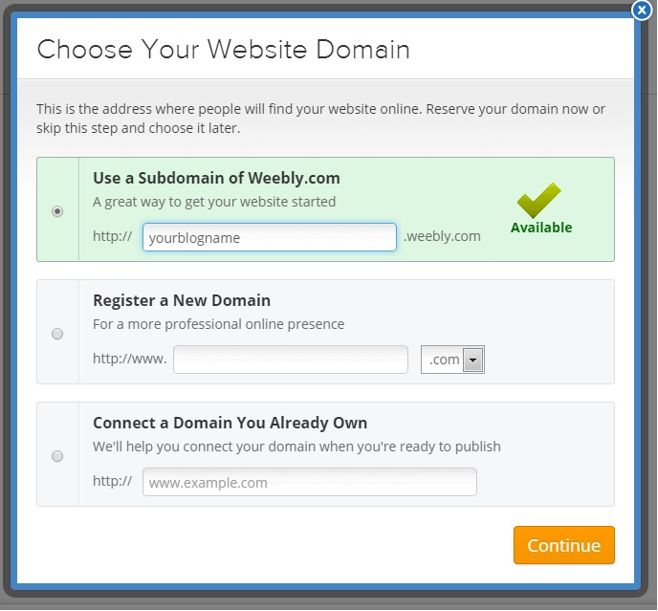
Pick a free sub-domain for your blog

Slide 6
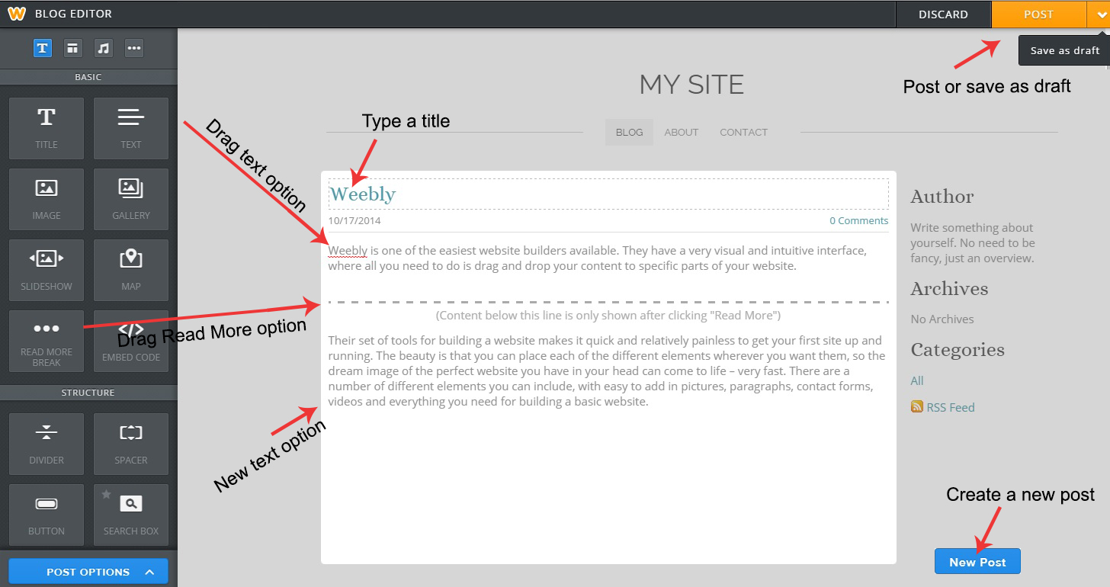
Create your first post

Slide 7
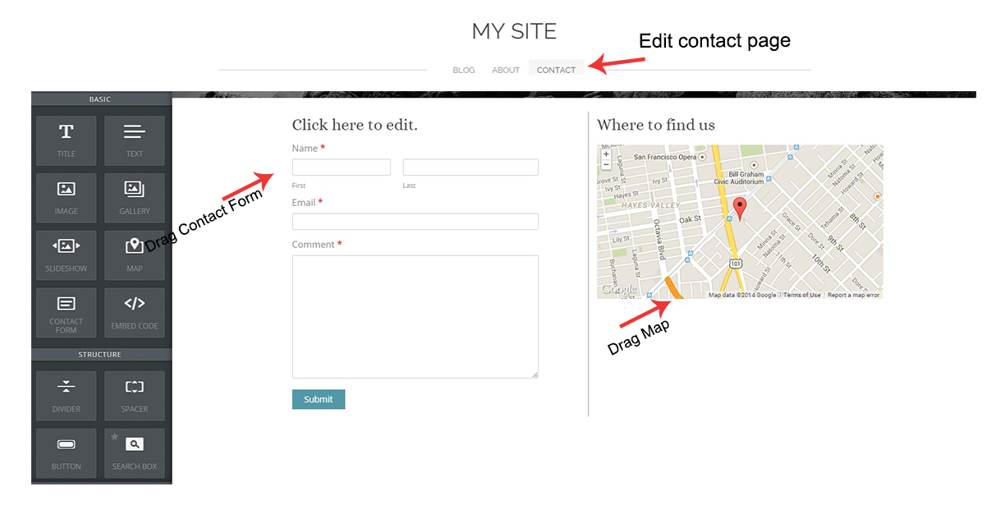
edit your contact page

Slide 8
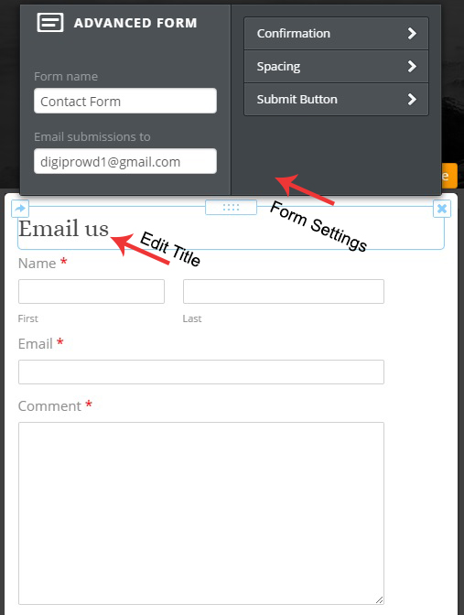
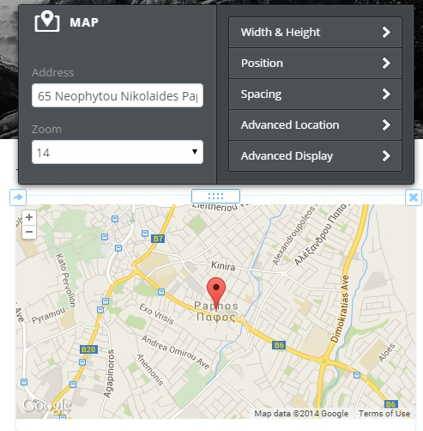
Edit options
CONTACT FORM
MAP OPTIONS

Slide 9
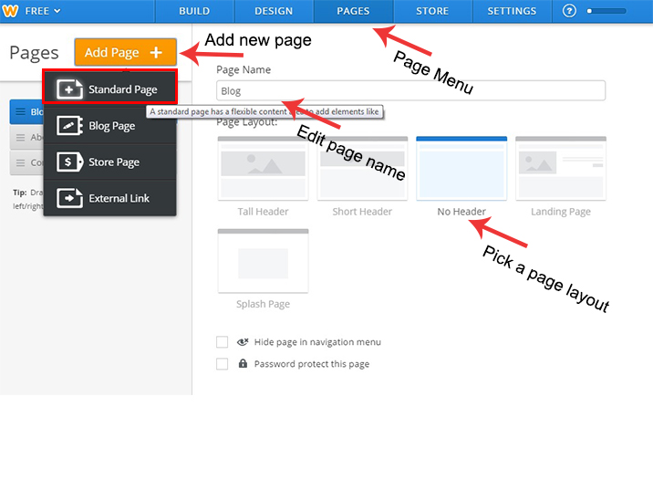
Add a new page “gallery “

Slide 10
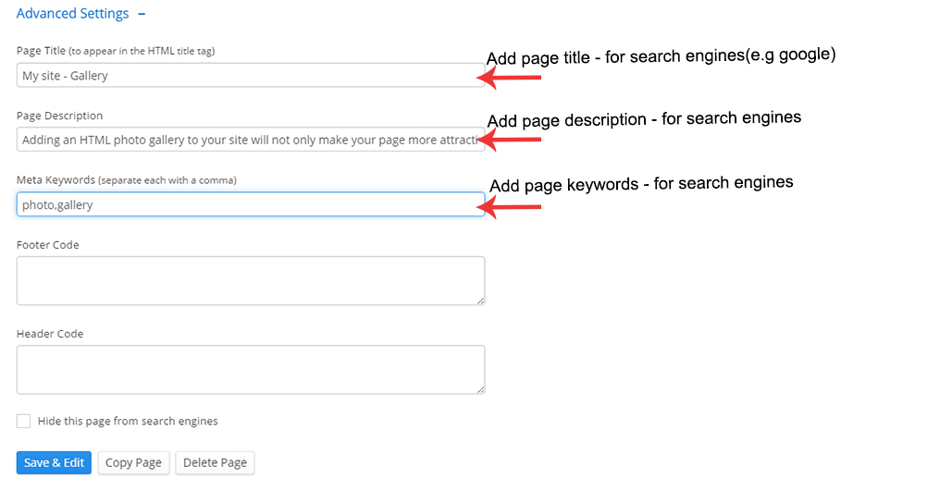
Advanced page settings

Slide 11
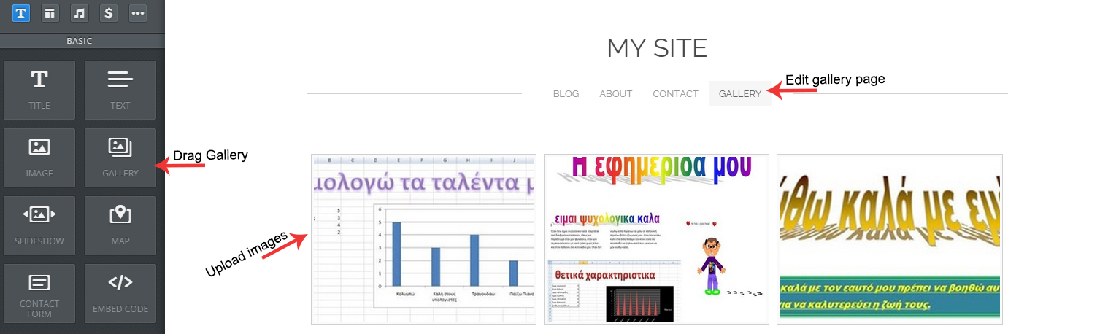
finalize gallery page

Slide 12
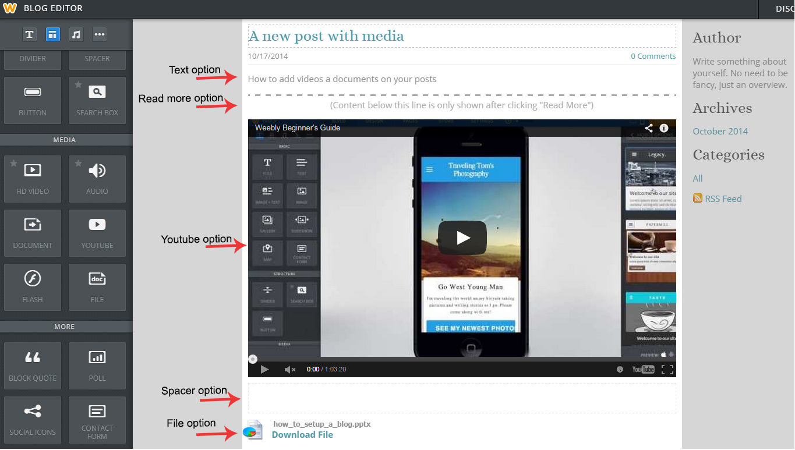
Add post with video and documents

Slide 13
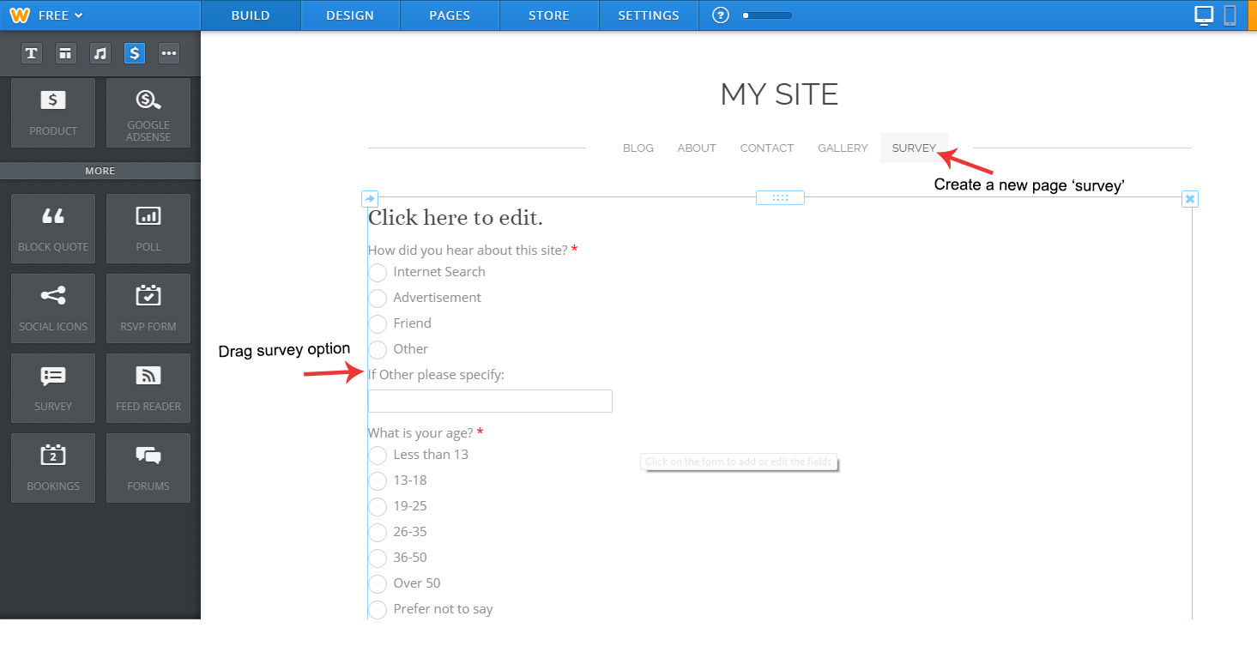
Create a new page “survey”

Slide 14
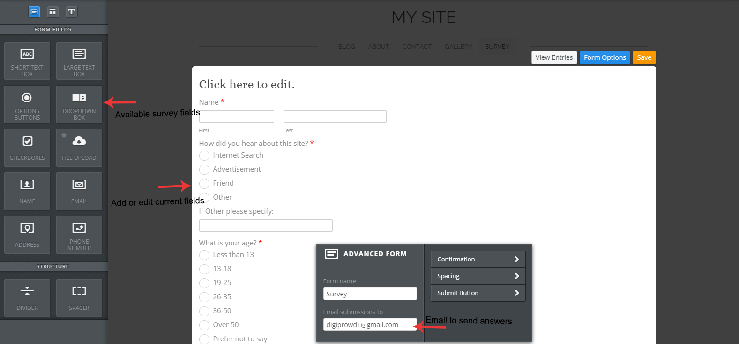
Edit survey fields

Slide 15
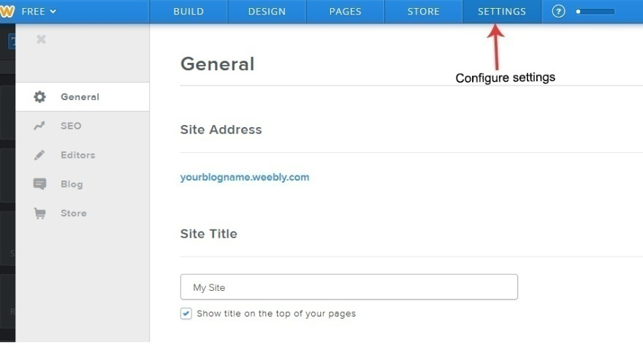
Configure blog settings
Site title : Your blogs name.
Site Address : Your blogs subdomain(URL)
Site password : Adds password to pages
Facebook sharing: Integrate your facebook page with your blog
SEO site description: For search engine optimization
SEO site keywords: For search engine optimization
BLOG general settings:Enable/Disable comments,set posts per page,add spam protection

Slide 16
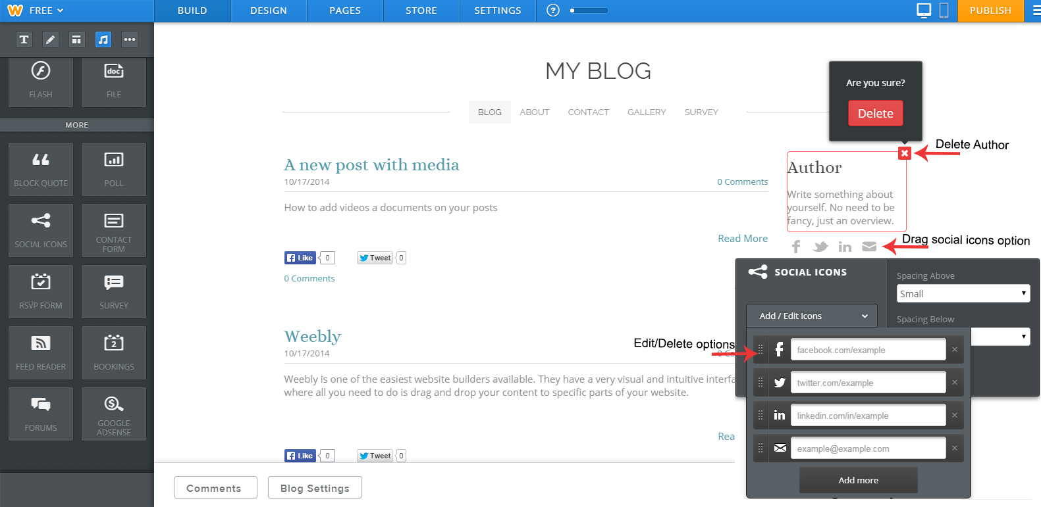
CUSTOMIZE YOUR BLOG PAGE

Slide 17
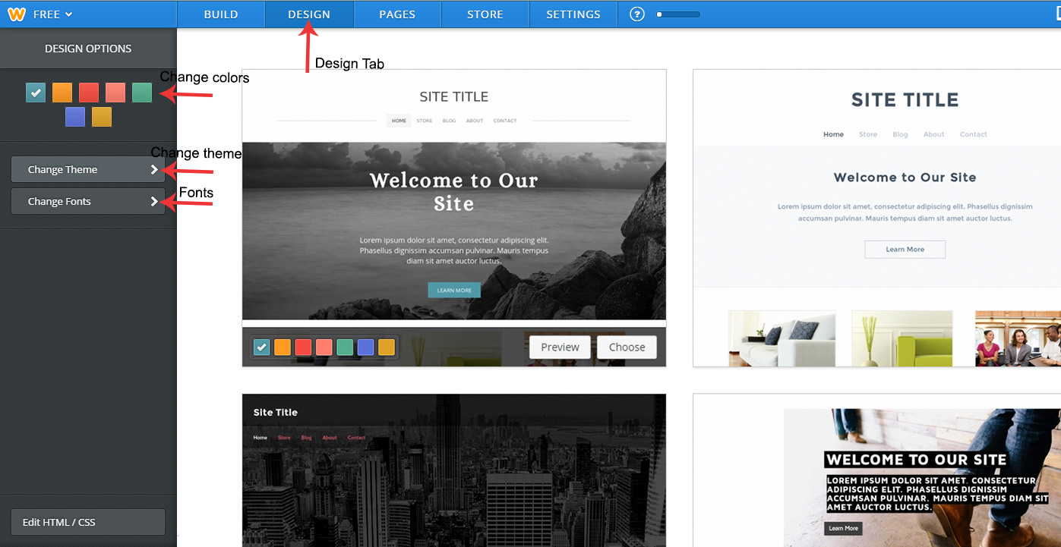
Find a new theme

Slide 18
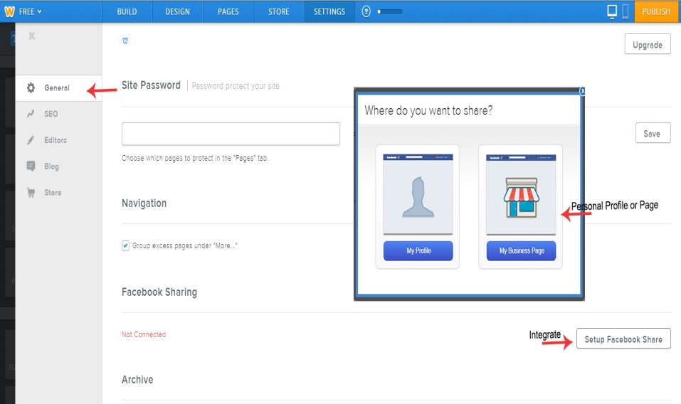
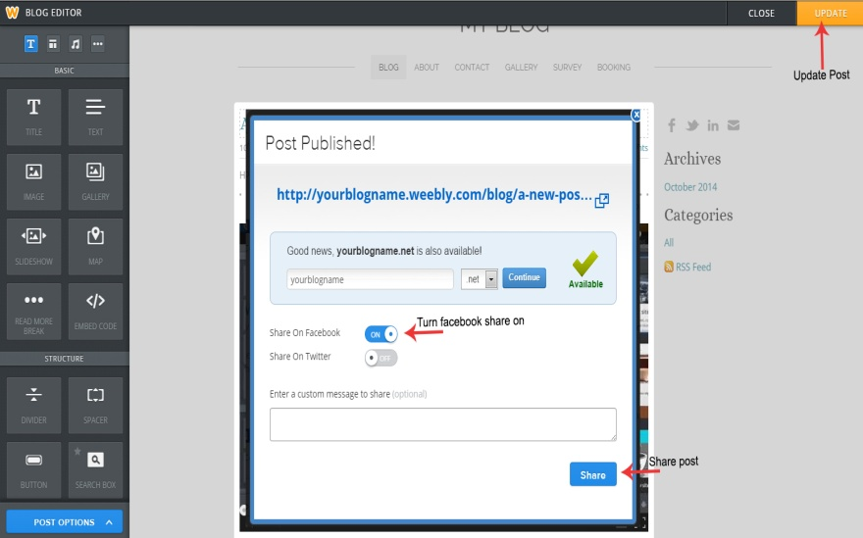
Integrate your posts with facebook

Slide 19
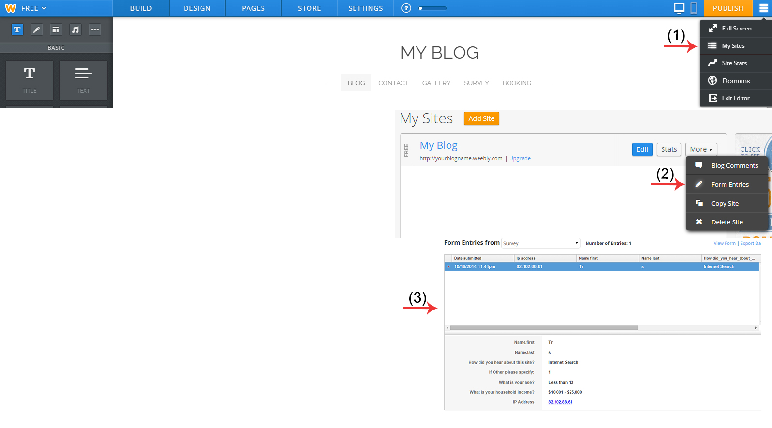
Check your survey page entries

Slide 20
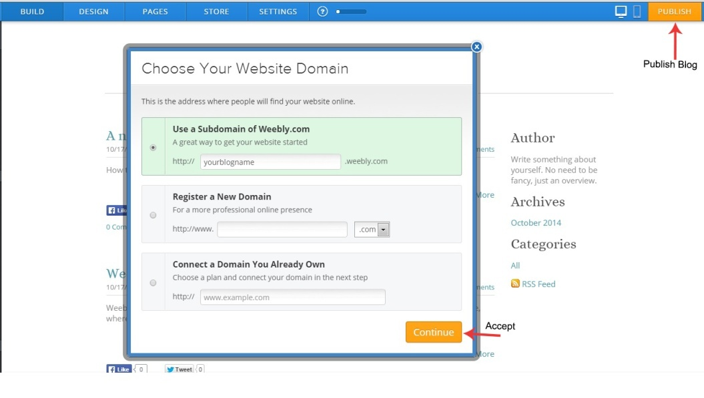
Publish and view your blog
To view your blog , type the sub-domain you choose in your internet browser’s address bar.

Slide 21
Online tutorials
http://hc.weebly.com/hc/en-us/sections/200354313-Beginner-s-Guide-to-Weebly
http://hc.weebly.com/hc/en-us/sections/200362446-Live-Training-Webcasts

