Slide 1
Types of Processing
Problem Solving

Slide 2
Presentation Structure/Learning Cycle
1. Set the wider picture and objectives

Slide 3
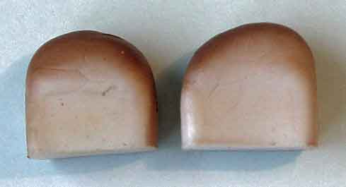
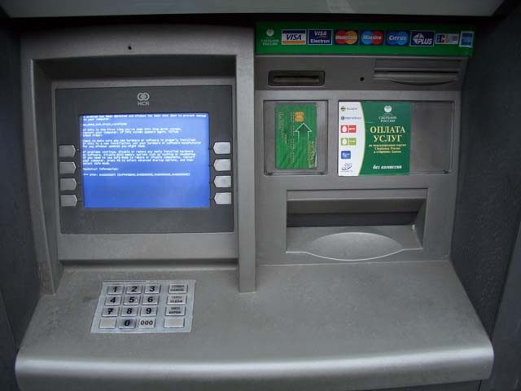
Types of Processing
Batch Processing
Transaction Processing
Real-Time Processing

Slide 4
Transaction Processing
What is POS ?
What is a transaction ?
A piece of bussiness
An event
An order is being made
Cash is withdrawn from a bank
Goods are paid for and stock levels are updated

Slide 5
Transaction Processing
This type of processing processes each transaction as it arises
Features of transaction processing:
A transaction is processed as it occurs
Each transaction is completed before the next transaction is begun

Slide 6
Presentation Structure
2. Determine the methods of assessing the outcomes /results/values
Scenarios and Verbal Questions
Students taking the role of a teacher
Multiple Choice
Powerpoint
Presentations
Written answers
Mind Maps

Slide 7
Presentation Structure
3. Describe the Execution
Why do supermarkets always have stock in their stores and shelves ?

Slide 8
Presentation Structure
4. Define learning value
Understand the given topic
Learn by not being spoon fed
Improve problem solving skills
Enabling students to apply knowledge accross the curriculum

Slide 9
Presentation Structure
5. Describe ways of motivation
Visit a Supermarket and divide into groups with different tasks
Jigsaw /snowball tasks
Take the role of a teacher
Work in groups and share ideas

