Slide 1
Education in the 21st Century
Vanessa Antoniadou, Academic Program Manager
28 May 2014

Slide 2
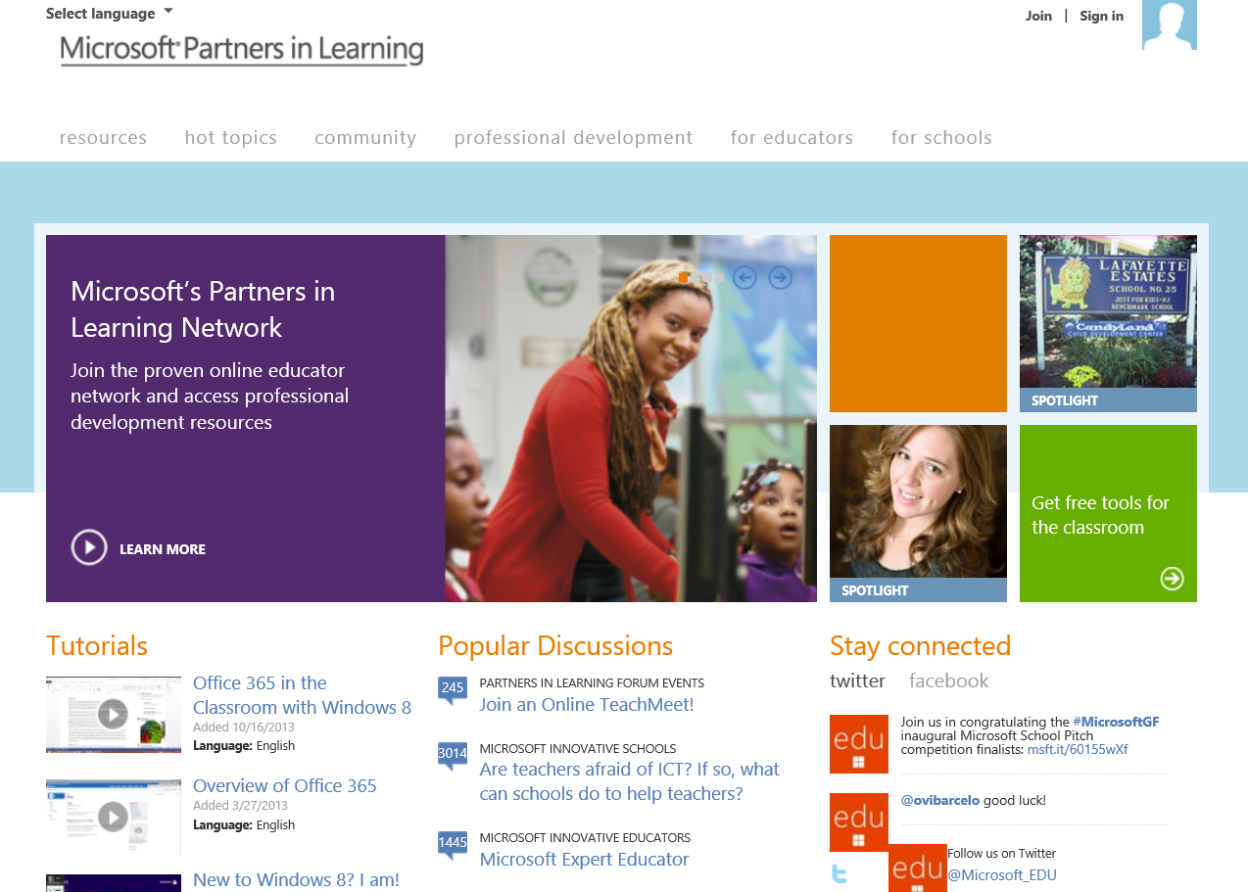
Partners in Learning Network
www.pil-network.com
Download free tools and applications
12,000+ learning activities and lesson plans
Collaboration with like-minded teachers
Professional development for teachers
Hot topics discussions, discussion forums

Slide 3














Professional Development and Badges
Badges for teachers: your achievements are recognized, earn badges for the skills and knowledge that are earned and shared
Badges for schools: Mentor, World Tour (applications open once a year).
Teaching with technology: 6 online learning courses to help you integrate technology into teaching practices and enable 21st century skills acquisition.
Windows in the Classroom: a series of videos that show real world examples of how software and devices can be used to enhance the learning experience.

Slide 4

Office Mix for PowerPoint
To Office Mix μετατρέπει τις PowerPoint παρουσιάσεις σας σε διαδραστικά διαδικτυακά μαθήματα (mix).
Περιλαμβάνει ότι χρειάζεστε για να το πραγματοποιήσετε: ηχογραφήστε, βιντεογραφήστε, σημειώστε πάνω στις διαφάνειες, προσθέστε κουίζ, ασκήσεις, ιστοσελίδες, κατευθείαν από το PowerPoint.
Προσθέστε ασκήσεις του CK-12 Foundation, Videos του Khan Academy, προσομοιώσεις για τη Φυσική από το PhET Sims κτλ.
Δημοσιεύστε τα μαθήματά σας και δείτε στατιστικά που αφορούν τους μαθητές σε σχέση με το μάθημα.
mix.office.com

Slide 5

Ένα ιστορικό, διαδραστικό χρονοδιάγραμμα…
Ένα εργαλείο για παρουσιάσεις.
Μπορεί να έχει διάρκεια από 1… μέχρι δισεκατομμύρια χρόνια!
Εξερευνήστε μία σειρά από ιστορικά δεδομένα, όπως άρθρα, φωτογραφίες, βίντεο, τραγούδια.
Δυνατότητα προσθήκης βιβλιογραφίας.
5 «συστήματα»: Κόσμος, Γη, Ζωή, Προϊστορία, Ανθρωπότητα
Big History Project
www.chronozoom.com

Slide 6

Photosynth
A software that was developed at Microsoft Live Labs.
Create a 3D experience from flat pictures.
Synth: take numerous pictures of a single item from different angles to create a 3D reality experience.
Panorama: create an immersive view of a particular place
Create a free account on Photosynth website to share your work and see what other are doing.
National Geographic is using Photosynth to create 3D images of global landmarks
http://ngm.nationalgeographic.com/photosynth/synth
http://photosynth.net/

Slide 7
OneNote
A digital notebook to gather, store and manage materials for teaching. Capture text, photos, video or audio files, Word documents, maps, Web articles, spreadsheets, Visio diagrams and handwritten notes
Works with Outlook, Word, PowerPoint, Internet Explorer.
Shared Notebooks (online, SharePoint)
Easy to organise and search for information
PDF printout within the notebook
Send by email
Create tables
Calculations

Slide 8
Office 365 for Education
A collaboration/communication platform
A2 Plan is Free for academic institutions (schools, universities).
To sing up: http://office.microsoft.com/en-us/academic/compare-office-365-education-plans-FX103045755.aspx
Visit Office 365 Trust Center for privacy and security: http://office.microsoft.com/en-gb/business/office-365-trust-center-cloud-computing-security-FX103030390.aspx
A2 Free Plan Includes:
  SharePoint Online for document sharing and management, 25GB of personal storage for each user
  Exchange Online for email and shared calendar with 50GB storage
  Lync Online for video conferencing, online meetings
  Yammer for internal social networking within your school

Slide 9


Vanessa Antoniadou
A-vanean@microsoft.com
VanessaAnt
Microsoft Cyprus

