Slide 1
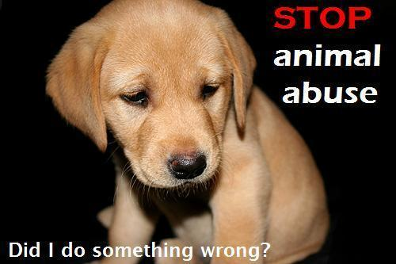
INITIATIVE & SELF-DIRECTION: Animal Abuse

Slide 2
INITIATIVE & SELF-DIRECTION: Animal Abuse
Identify the whole picture
Wider picture:
To help children identify the negative effects of animal abuse on society as a whole and take initiative towards combating the problem.
Specific objective: Awareness of the problem

Slide 3
INITIATIVE & SELF-DIRECTION: Animal Abuse
Identify Learning Evidence
See them taking steps e.g.
Charity
animal adoption
report animal abuse
voluntary work (protect animals).

Slide 4
INITIATIVE & SELF-DIRECTION: Animal Abuse
Describe the execution
- Authentic material: videos, photos, articles
- Ask about their personal experiences
- How they would react if they witnessed animal abuse
- How they would react if their pet was abused.
- Field trip to an animal shelter

Slide 5
INITIATIVE & SELF-DIRECTION: Animal Abuse
Define Learning Value
- Respect for nature and other forms of life
- Learn how to be responsible
- Respect animals, which in turn can lead to respect for other people, especially weaker ones (prevention of bullying).

Slide 6
INITIATIVE & SELF-DIRECTION: Animal Abuse
Describe ways of motivation
- Participate in a relevant event
- Adopt a class pet (e.g. fish)
- Arrange a visit from a shelter volunteer to speak to the children and bring some pets along (create awareness)
- Organise a charity event (for students and parents) to raise money for a shelter

