Slide 1
Singular and plural nouns

Slide 2
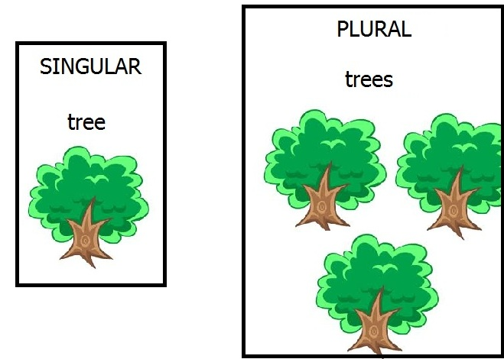
When we are talking about more than one person, animal, place or thing we use the plural form.

Slide 3
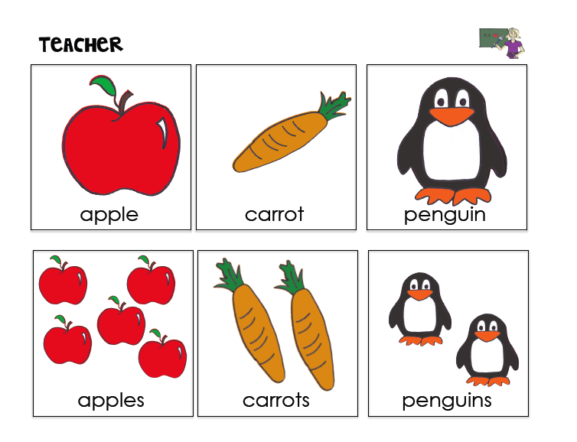
READ AND SAY

Slide 4
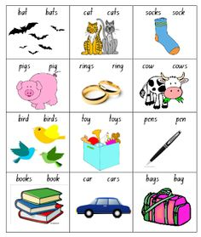
Circle the correct word

Slide 5
The End

