Slide 1
The wheel

Slide 2
The wheel
From the very early designs used for pottery purposes to the most advanced contraptions known to mankind, the wheel has been continuously driving our civilization like a catalyst in a chemical reaction. We thought it would be a good idea to take a stroll through the many stages of the wheel evolution and see where it's heading now.

Slide 3
The History of The Wheel

Slide 5
Vocabulary:
Axle:
Ball bearings:
Dragged:
Contact:
Aluninium:

Slide 6
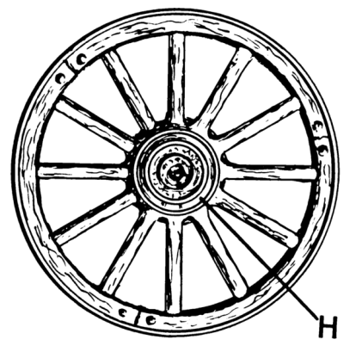
Thank You

